Slide 1

Hospital Management
System
By: Abdullah Hany, Ahmed Anwar, Ahmed Hazem
Ahmed Khaled, Ismail Mohamed

Slide 2


About our team
1
Experienced Developers
2
Domain Expertise
Our team comprises seasoned software engineers specializing in ASP.NET Core, MVC, and database management.
We have deep understanding of healthcare processes, ensuring the application meets real-world hospital needs.
3
Passion for Innovation
We are committed to delivering a cutting-edge solution that enhances patient care and administrative efficiency.

Slide 3

The need for a hospital management system
Centralized Data
Improved Efficiency
Consolidates patient records, appointments, and medical information for easy access.
Automates tasks, reduces paperwork, and streamlines administrative processes.
Enhanced Communication
Facilitates seamless communication among staff, patients, and medical professionals.

Slide 4
Key features of our application
Patient Management
Appointment Scheduling
Reporting and Analytics
Comprehensive patient profiles, medical history, and treatment plans. Our application provides a centralized repository for all patient-related information, enabling healthcare professionals to access essential details quickly and efficiently. This feature streamlines patient care coordination and facilitates informed decision-making.
Automated appointment scheduling, reminders, and online booking options. The application automates appointment scheduling, eliminating manual processes and reducing errors. It also sends timely reminders to patients, improving appointment attendance and minimizing no-shows. Moreover, patients can conveniently book appointments online, enhancing access to care and reducing wait times.
Real-time dashboards, performance tracking, and customizable reports. The application offers robust reporting and analytics capabilities. Real-time dashboards provide insights into key performance indicators, facilitating informed decision-making. It also enables customizable reports, allowing users to generate tailored data visualizations for specific needs. The platform's analytical features empower healthcare organizations to track trends, identify areas for improvement, and optimize resource allocation.

Slide 5

Leveraging ASP.NET Core and the MVC pattern
Model
Controller
Represents data and business logic, ensuring accurate data management.
Handles user interactions and data requests, facilitating seamless application flow.
1
2
3
View
Presents data to the user, providing a user-friendly interface.

Slide 6





User registration and authentication
User Registration
Allows users to create secure accounts with personalized credentials.
Authentication
Verifies user identity and grants access to authorized features.
Role-Based Access
Limits access to specific features based on user roles, ensuring data security.

Slide 7
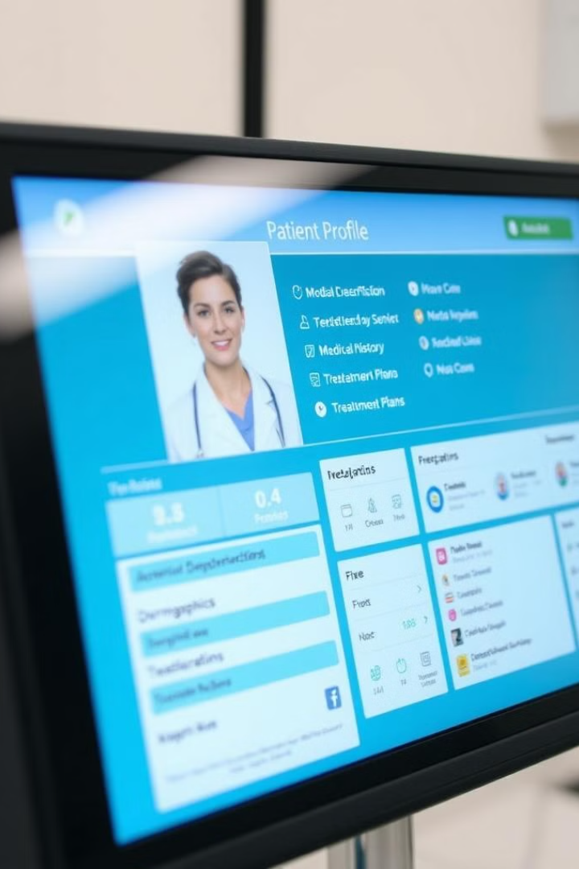
Patient management functionality
Demographics
Name, Address, Contact Information
Medical History
Past illnesses, surgeries, allergies, and medications.
Treatment Plans
Customized treatment plans, progress notes, and medical records.

Slide 8




Scheduling and appointment management
Appointment Scheduling
Reminders
Enables efficient appointment booking, ensuring timely access to care.
Sends automated appointment reminders to patients and staff.
Location Tracking
Appointment Confirmation
Provides real-time location information for patients and staff.
Confirms appointments and sends updates to patients and staff.

Slide 9
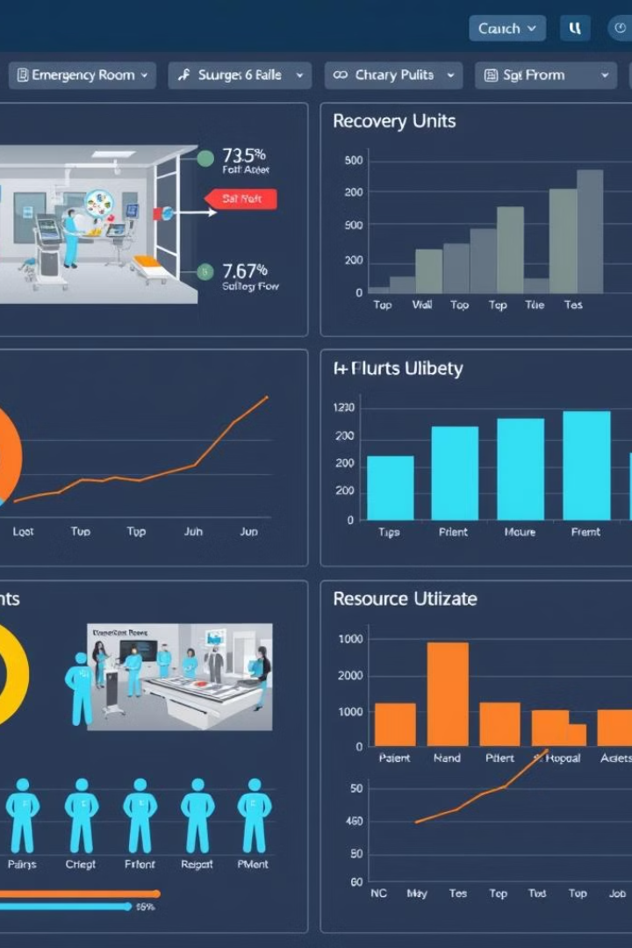
Reporting and analytics dashboard
1
Patient Flow Analysis
2
Resource Utilization
Tracks patient admissions, discharges, and waiting times.
Monitors bed occupancy, staff availability, and equipment usage.
3
Financial Performance
Provides insights into revenue, expenses, and billing cycles.

Slide 10
Future roadmap and enhancements
Integration with Electronic Health Records (EHR)
Mobile App Development
A mobile app for patients to access their medical records, schedule appointments, and communicate with healthcare providers.
Seamless data exchange with EHR systems for comprehensive patient information.
Artificial Intelligence (AI) Integration
Utilizing AI algorithms for predictive analytics, patient risk assessment, and personalized care recommendations.

